Slide 1
Mild Master Neuroimaging pilot

Slide 2
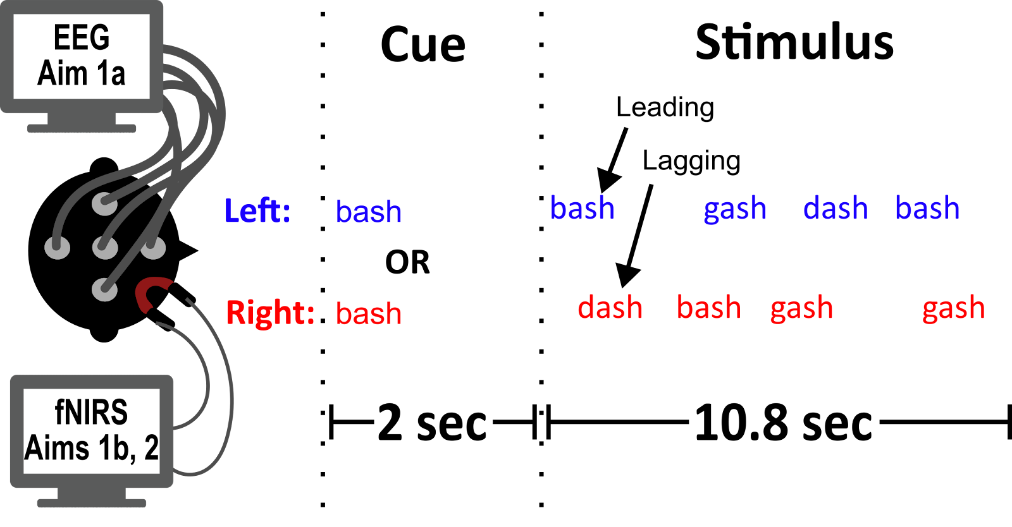
300 ms
50 ms
250 ms
9.6
16 token pairs * 600 ms/pair = 9.6 sec

Slide 3
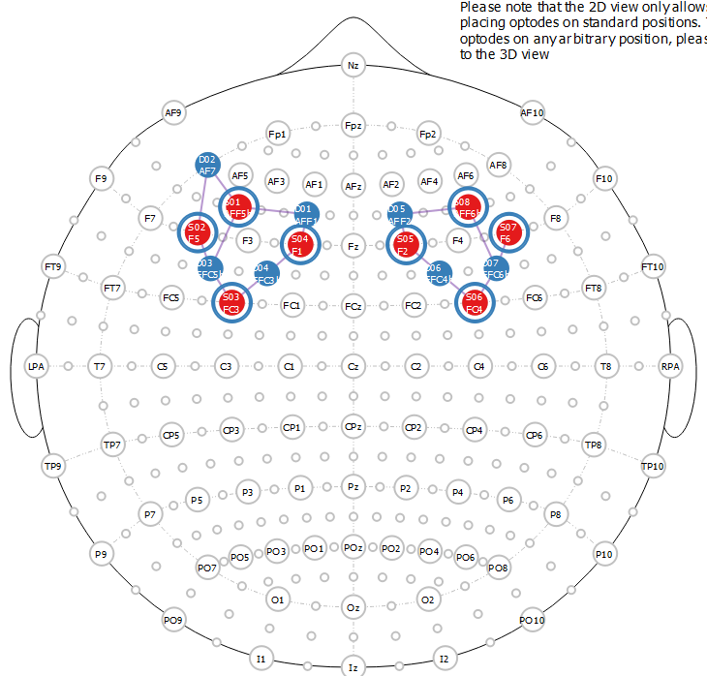
Imaging
32 channel EEG + fNIRS

Slide 4
Fullpilot1
50 us ITD, 500 us ITD, 5 deg ILD, 5 deg ILD + Mag
60 trials per condition (30 attend right, 30 attend left)
300 ms tokens
5 – 7 sec rest
Cue (1.8 s)
Stim (4.8 s)
Rest (9-13 s)
Min = 11.6, max = 12.6

Slide 5
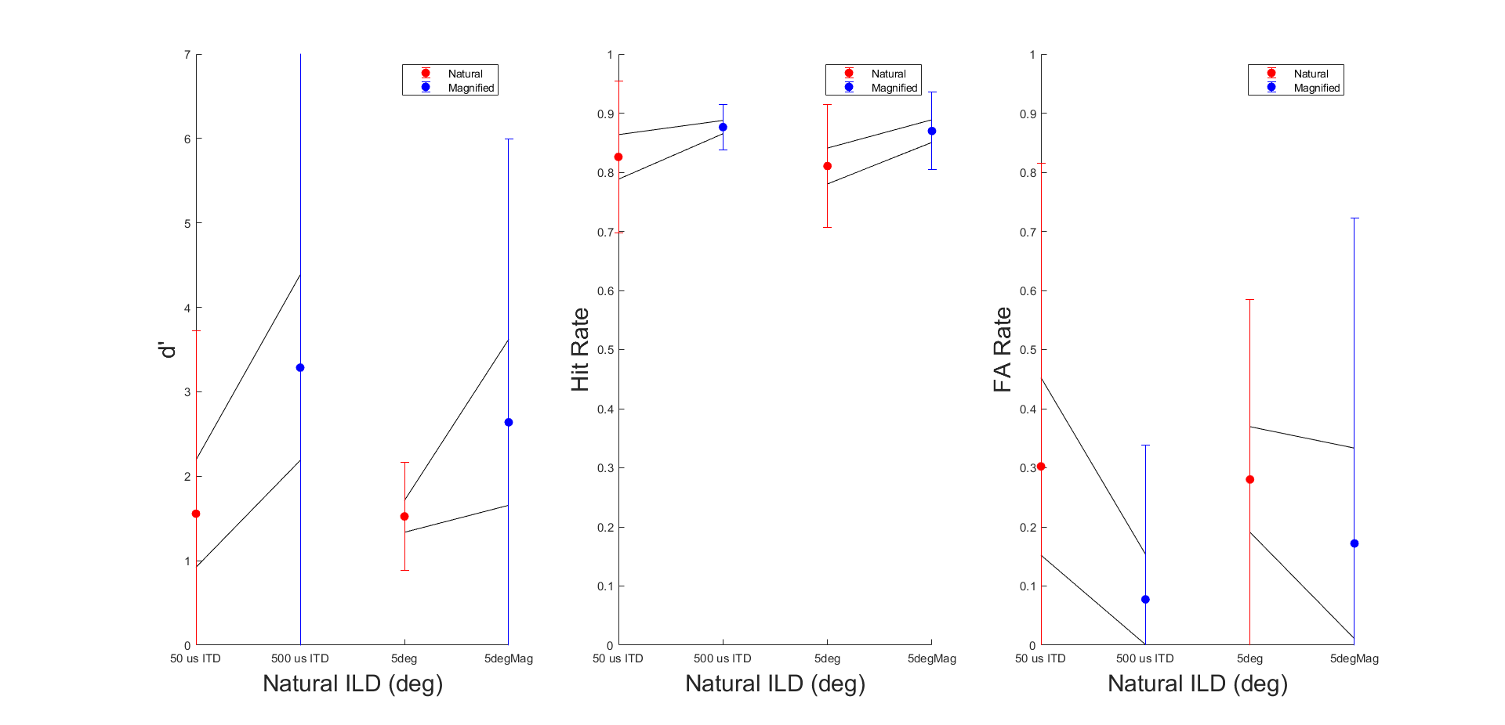
Behavior

Slide 6
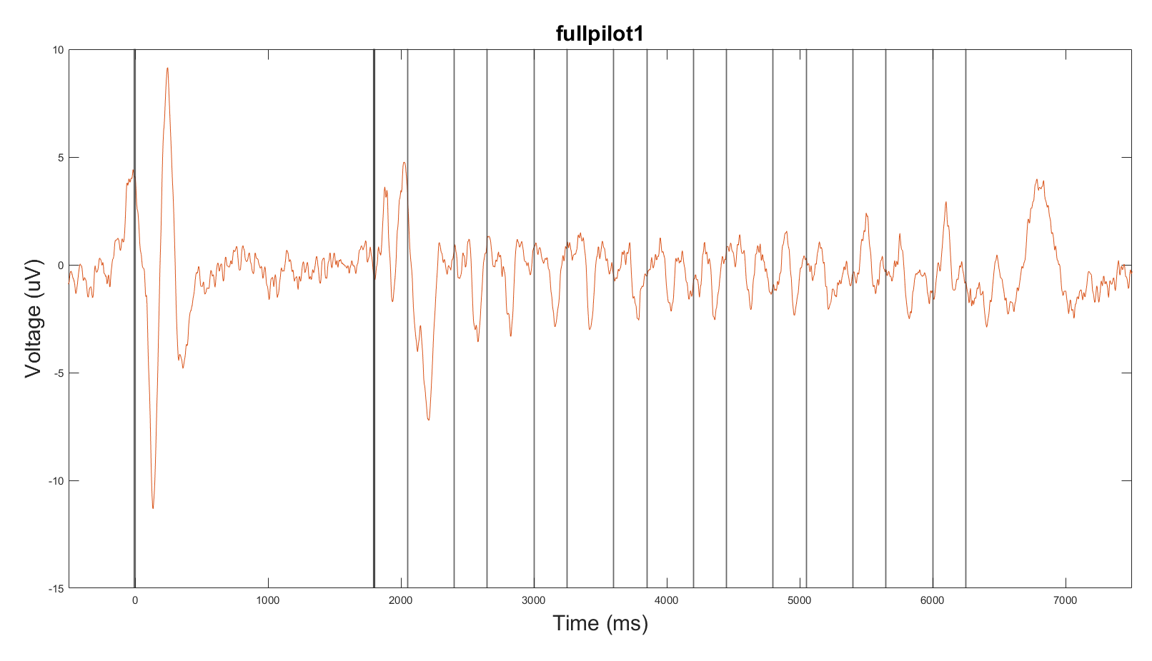
Whole Trial Mean Response over frontocentral channels

Slide 7
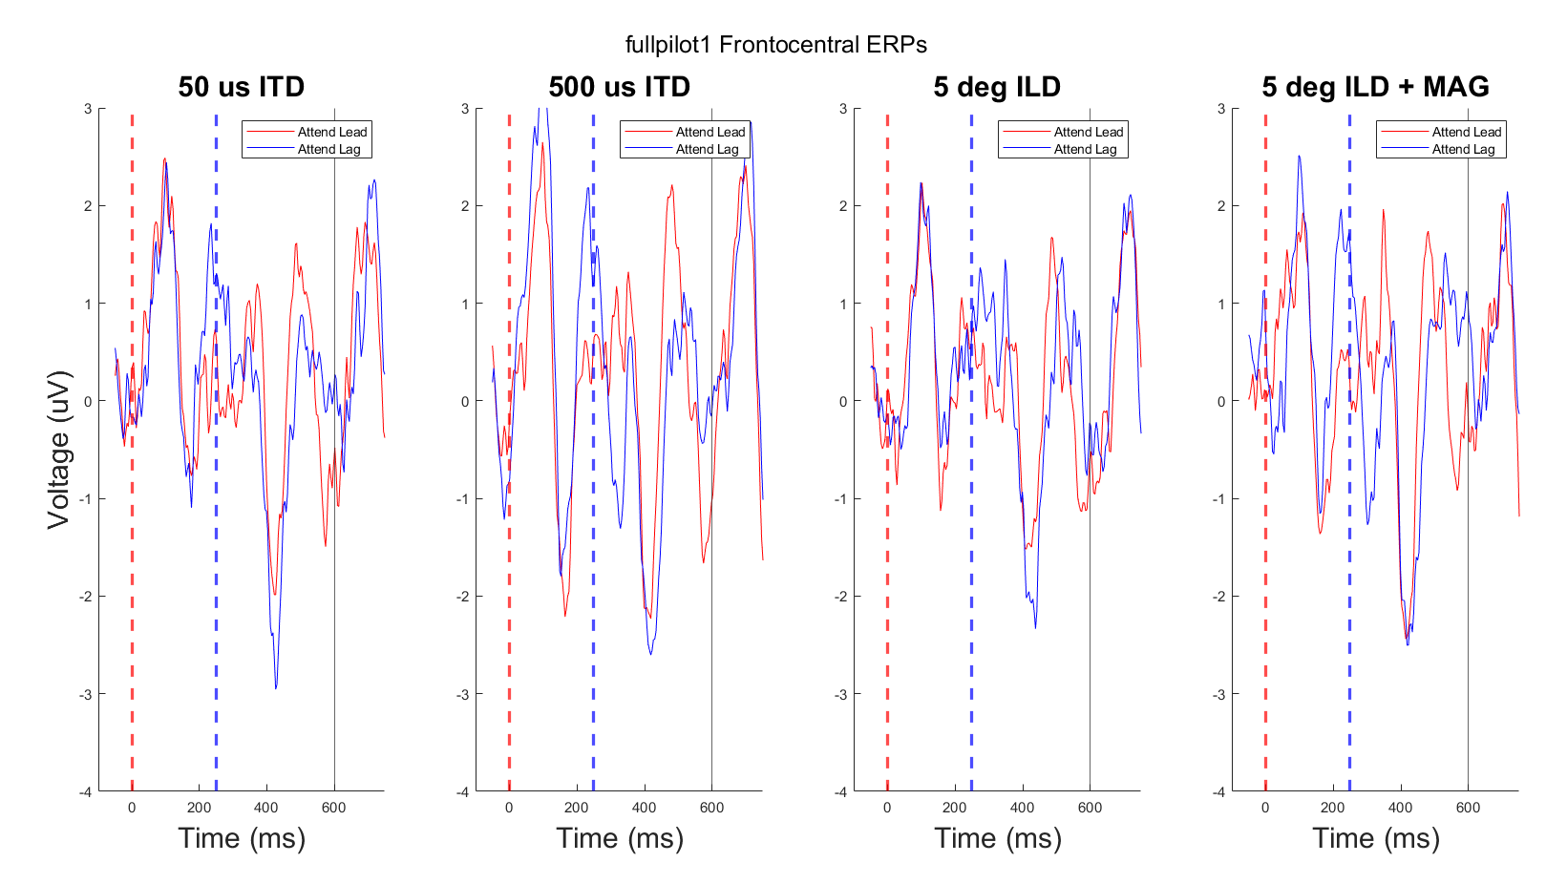
Attend Lead vs. Attend Lag

Slide 8
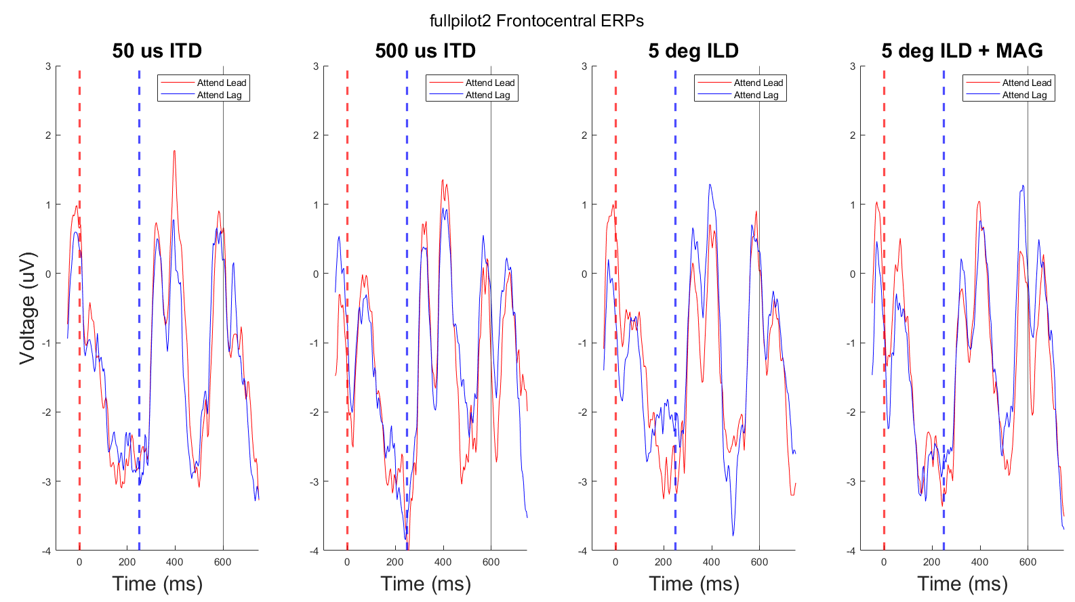

Slide 9
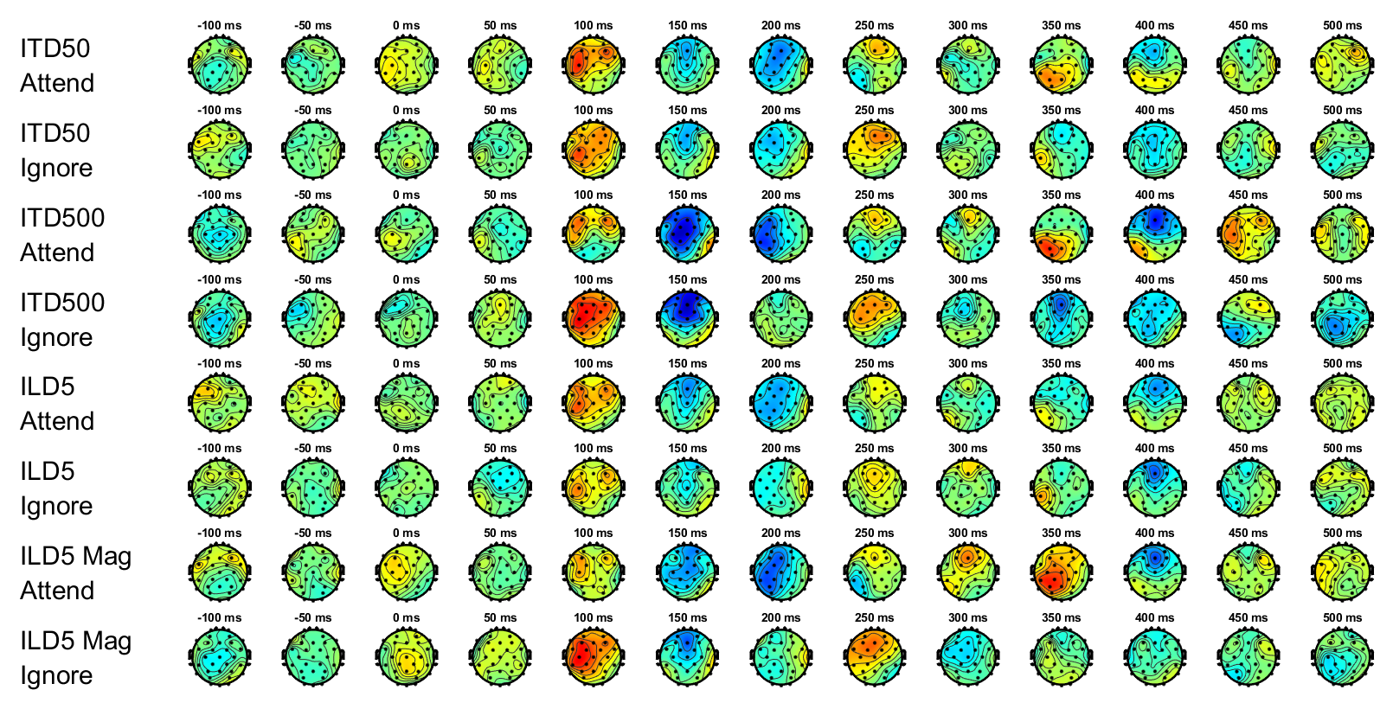
Mean ERP topographies

Slide 10
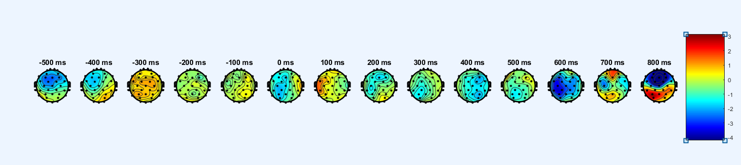
Button press topography

Slide 11
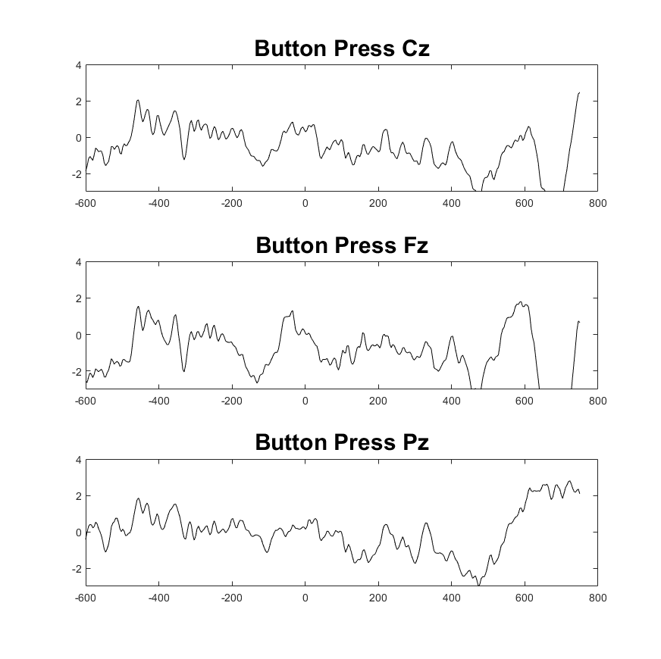
Button press at Cz, Fz, and Pz

Slide 12
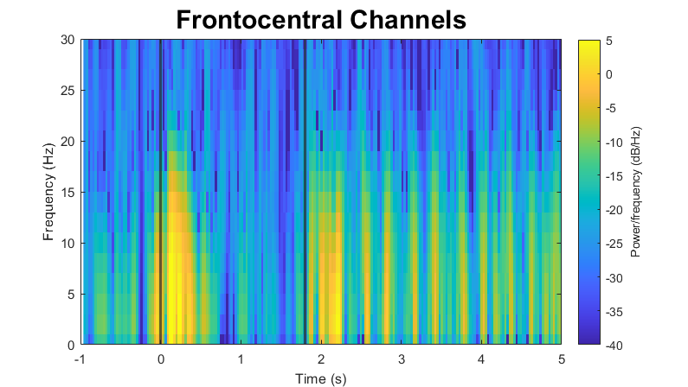
Spectrogram of whole trial

Slide 13
Spectrogram of whole trial

Slide 14
Alpha question from Ben
Need to subtract the mean response over the whole trial to see induced alpha more clearly?

Slide 15
I am confused about nirs
I am seeing negative going block averages, though I do see anticorrelation between HbO and HbR
Filter limits = [0.01,0.1]
Short channel regression included

Slide 16
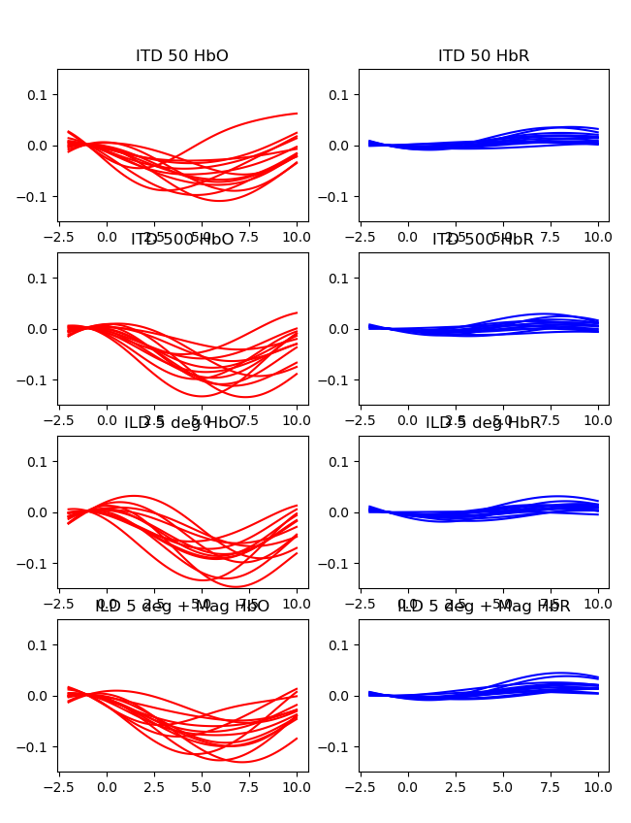
With 5-7 seconds of rest (fullpilot1)
DeltaHb (uM)
Time re: cue onset

Slide 17
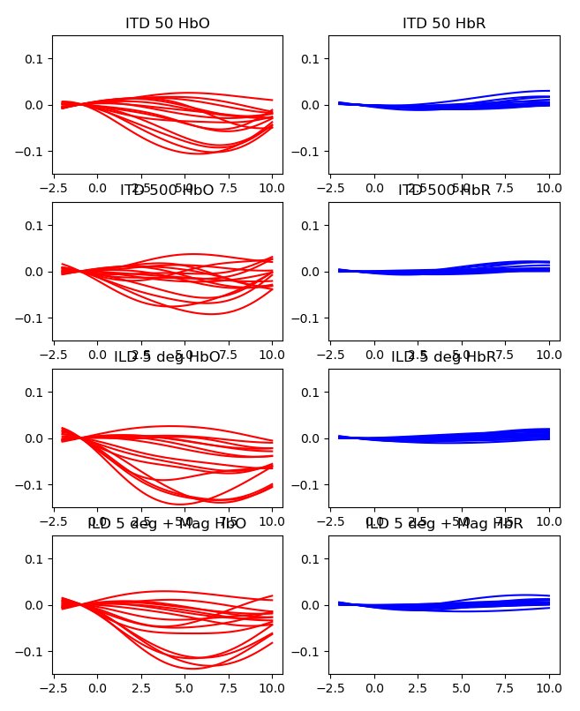
With 7-9 seconds of rest (fullpilot 2)
DeltaHb (uM)
Time re: cue onset

Slide 18
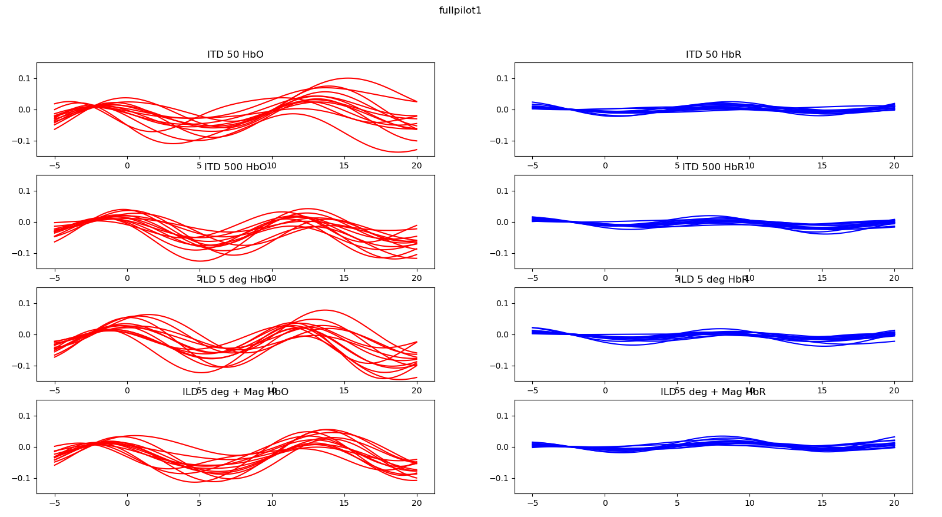
5-7 sec rest – 0.07 Hz task rate

Slide 19
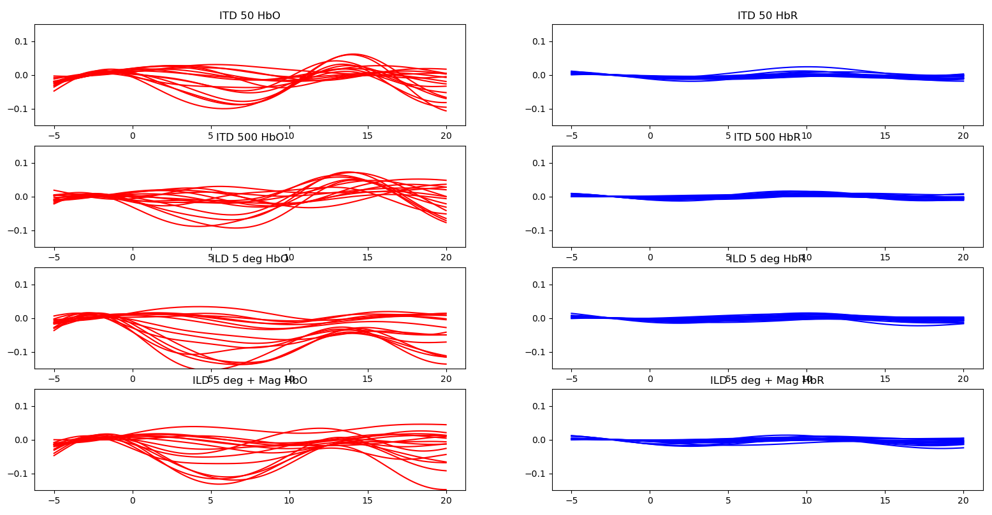
7-9 sec rest – 0.067 Hz task rate

Slide 20
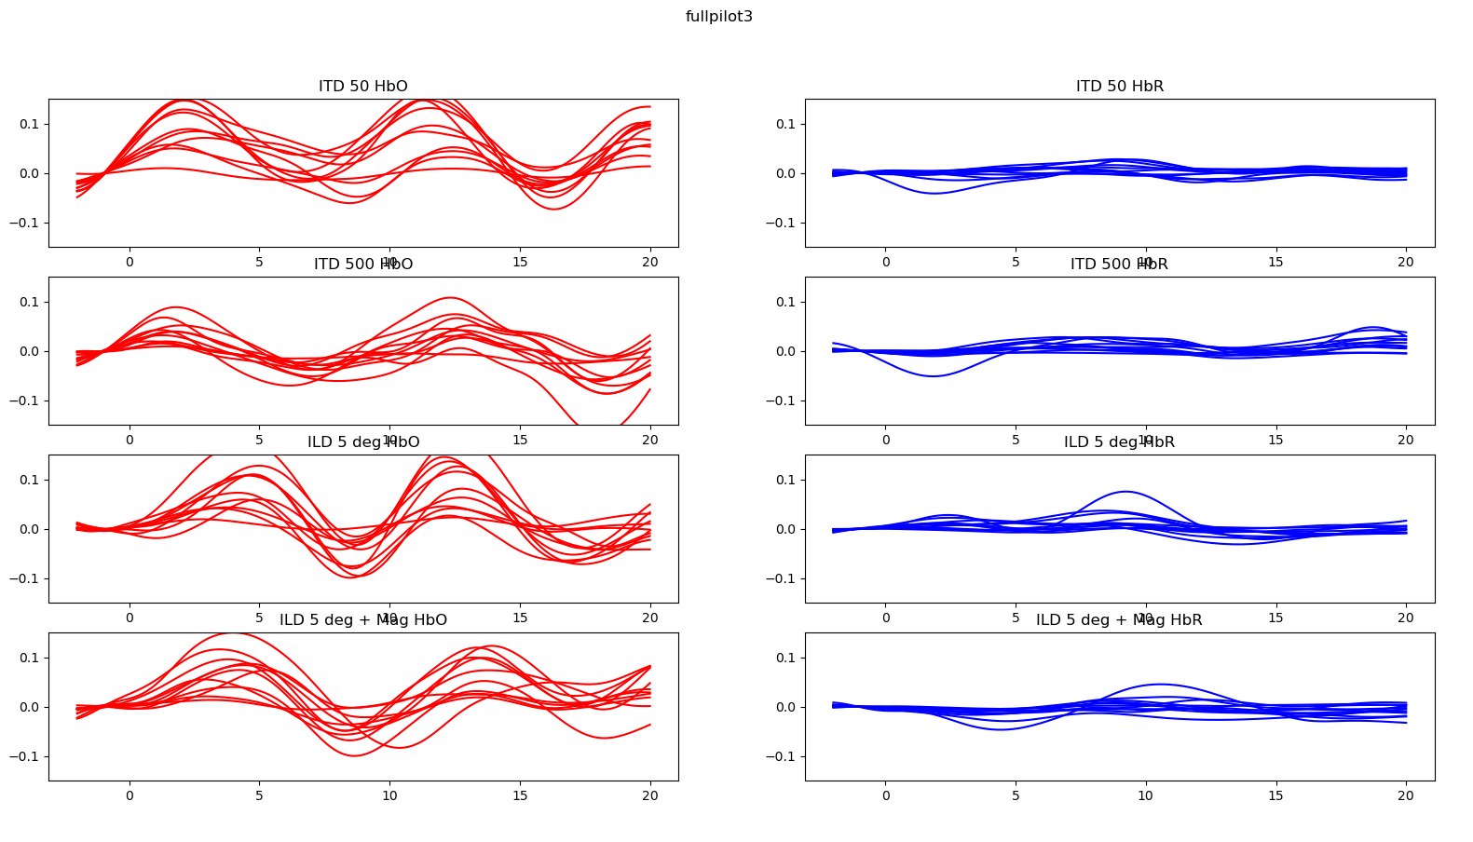
9-13 seconds rest; Filter limits [0.01,0.3], task rate 0.05 - 0.06 Hz

Slide 21
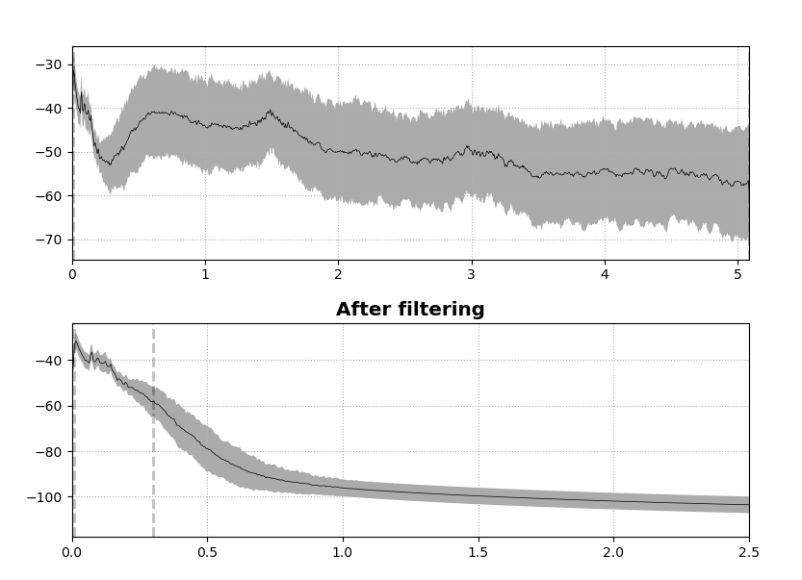
fullpilot1 fNIRS Spectrum
Before filtering

Slide 22
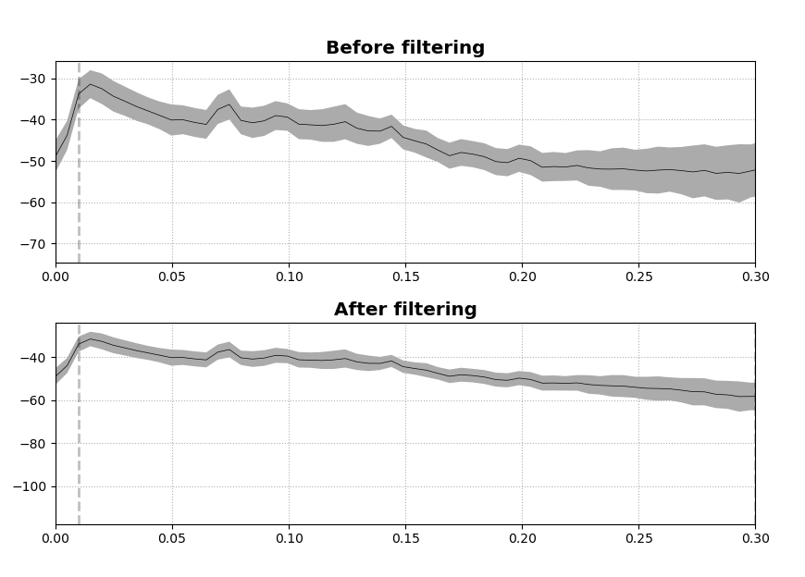

Slide 23
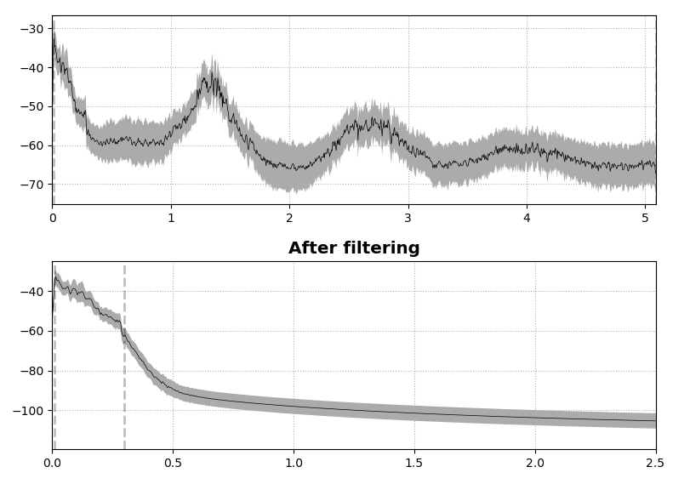
fullpilot2
Before filtering

Slide 24
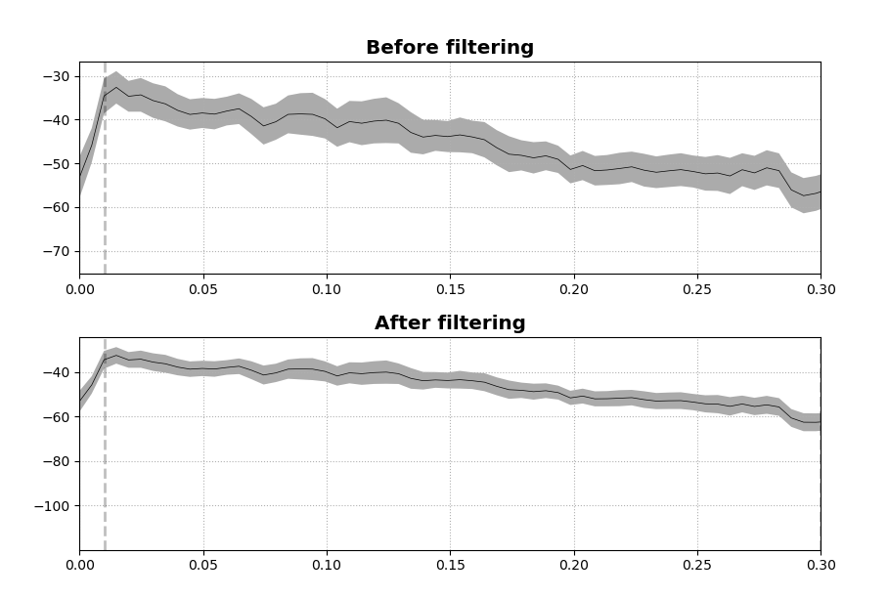

Slide 25
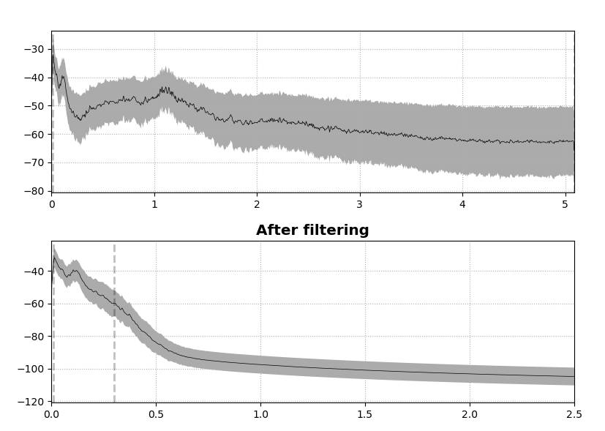
fullpilot3
Before filtering

Slide 26
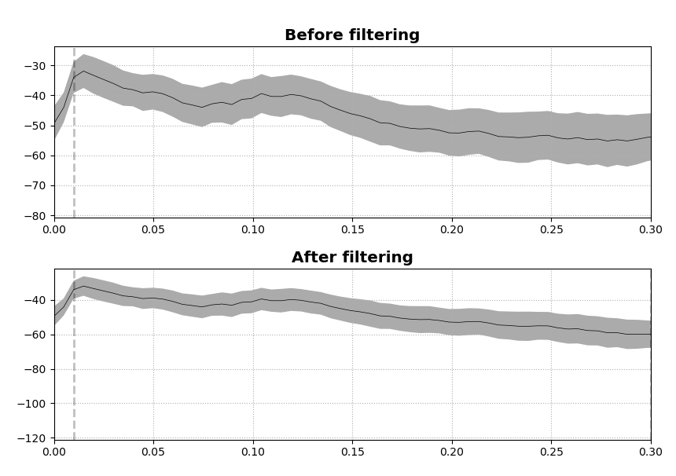

Slide 27
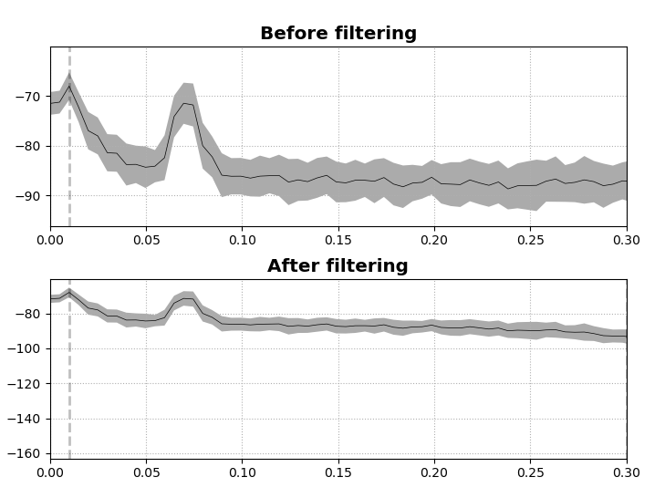
Phantom test – eeg on, camera off

Slide 28
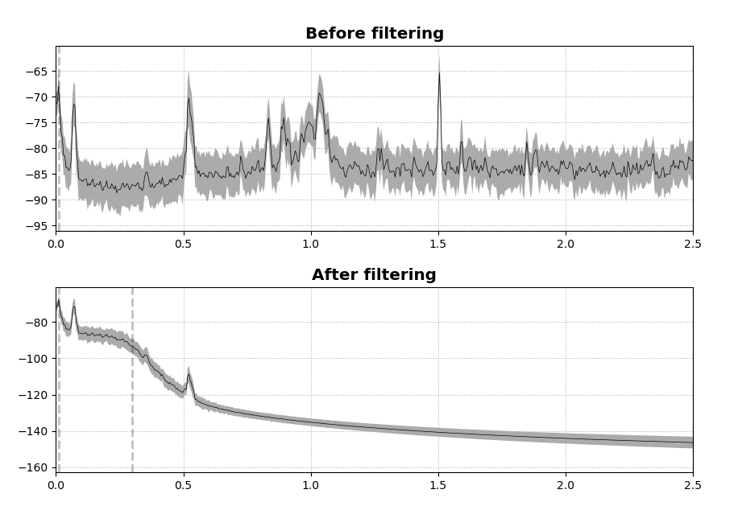

Slide 29
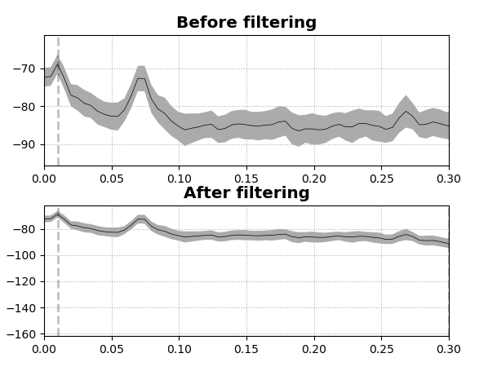
Phantom test – eeg off, camera off

Slide 30
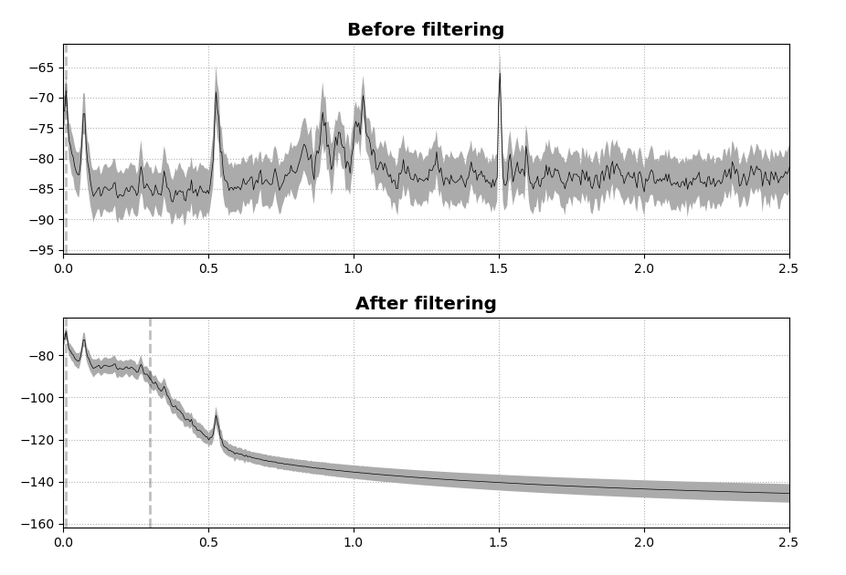

Slide 31
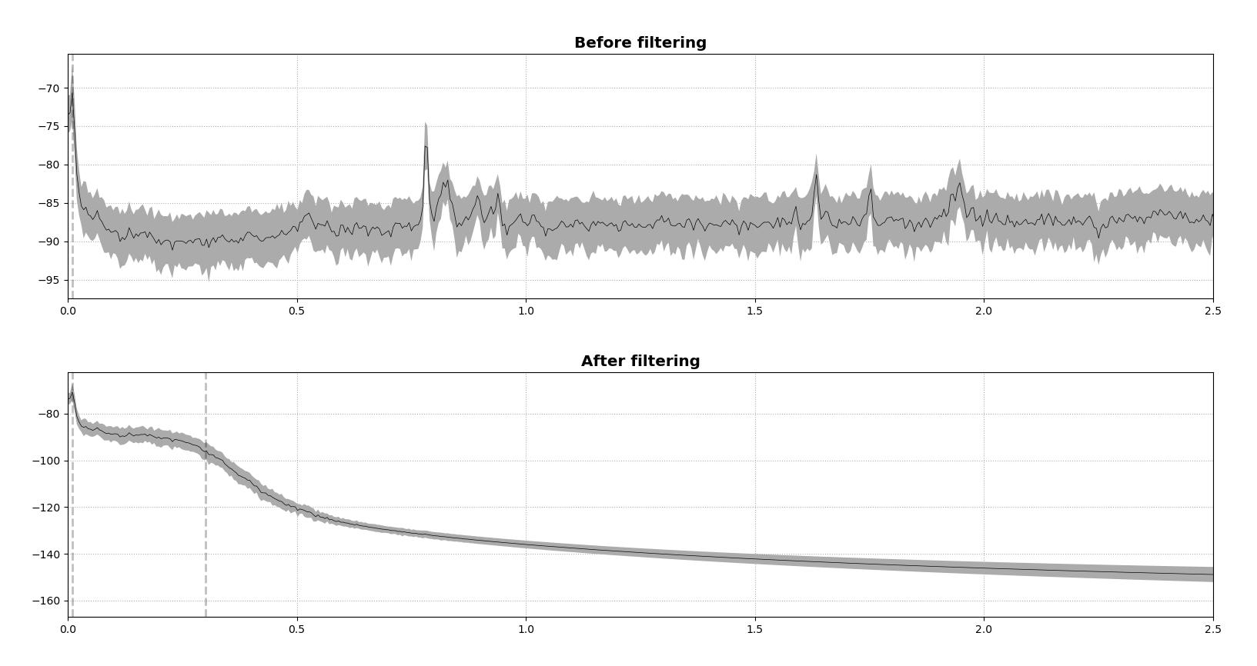
Phantom no camera no lights no eeg

Slide 32
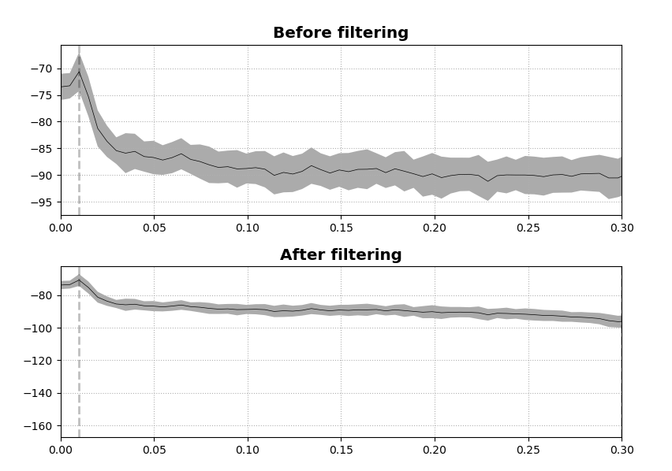

Slide 33
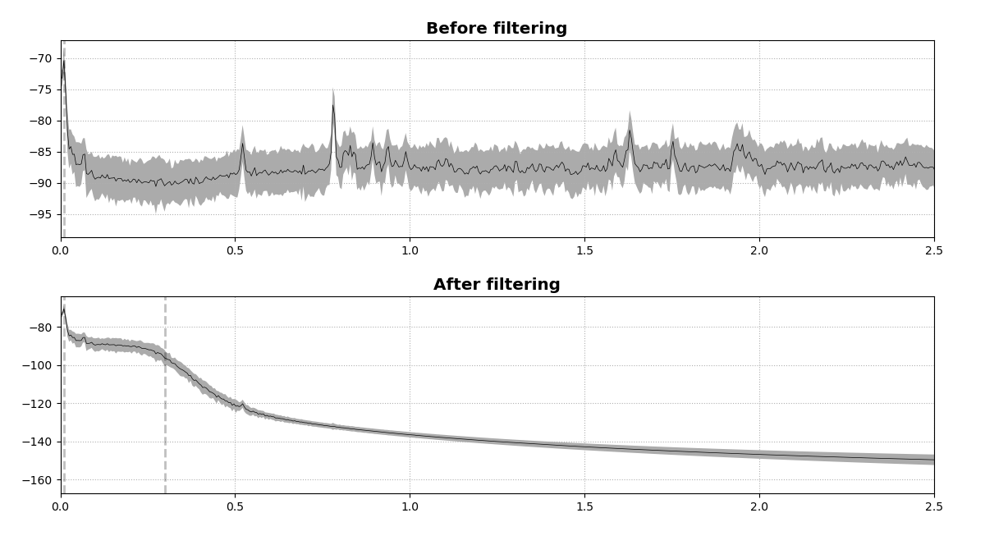
Phantom no camera no lights no eeg no monitor

Slide 34
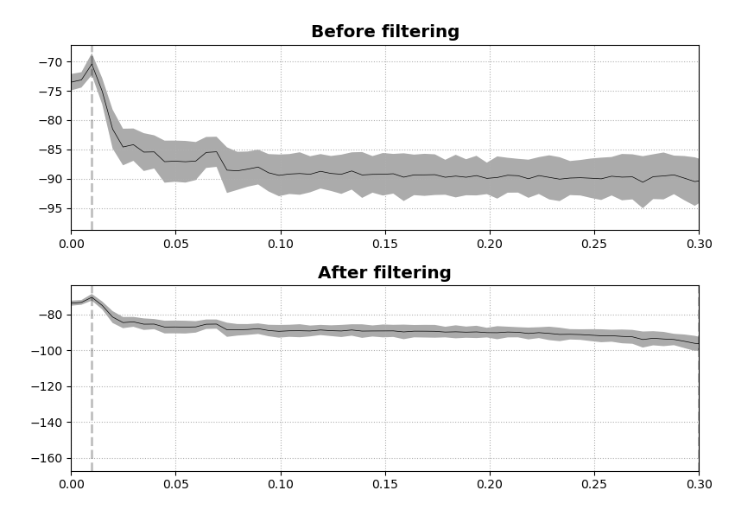

Slide 35
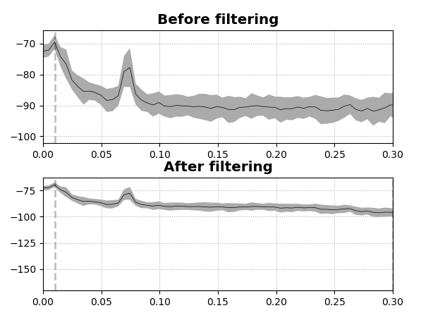
Lights on, cpod on

Slide 36
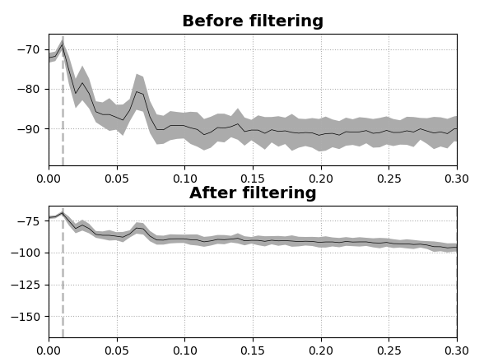
Lights off, cpod on

Slide 37
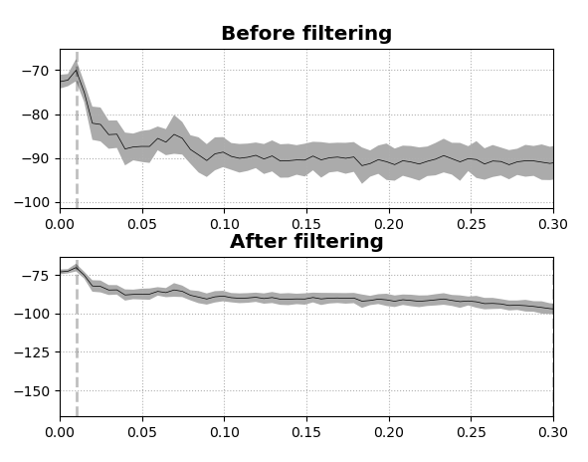
Lights on, cpod covered

Slide 38
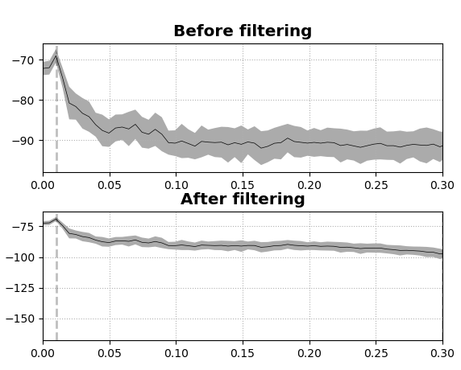
Lights off, cpod covered

Slide 39
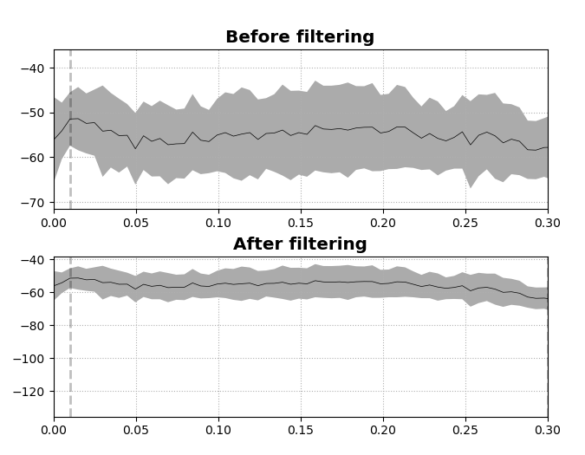
Everything on, cpod covered

Slide 40
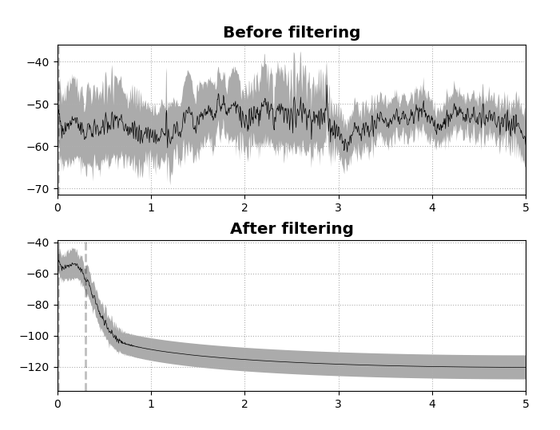

Slide 41
ALPHA PLOTS

Slide 47
More ERP Analyses

Slide 48
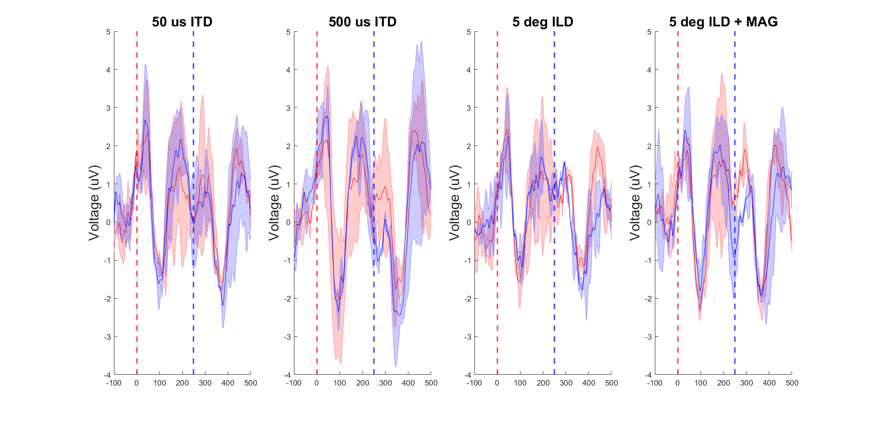
At Cz, ignoring first word pair

Slide 49
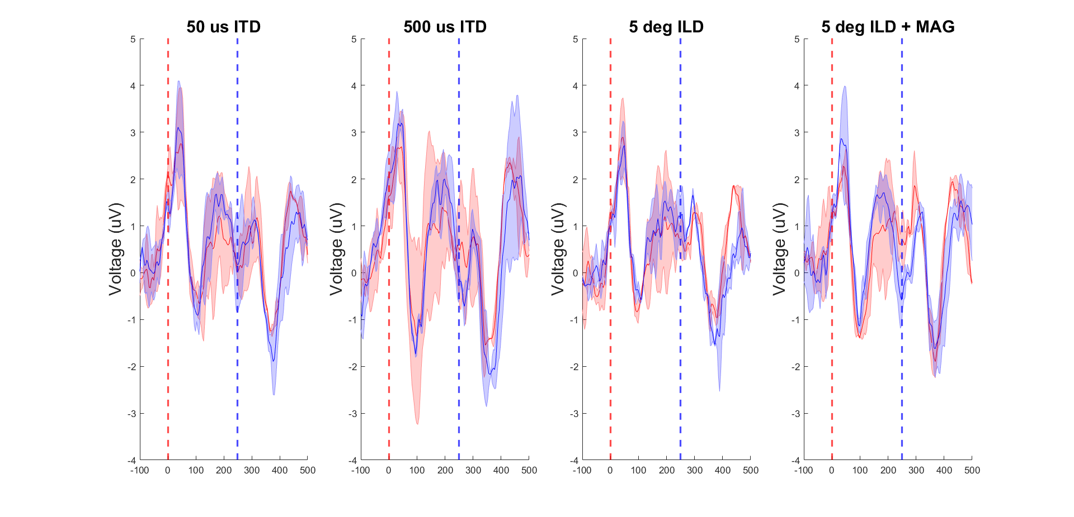
Frontocentral channels, ignoring first word pair

Slide 50
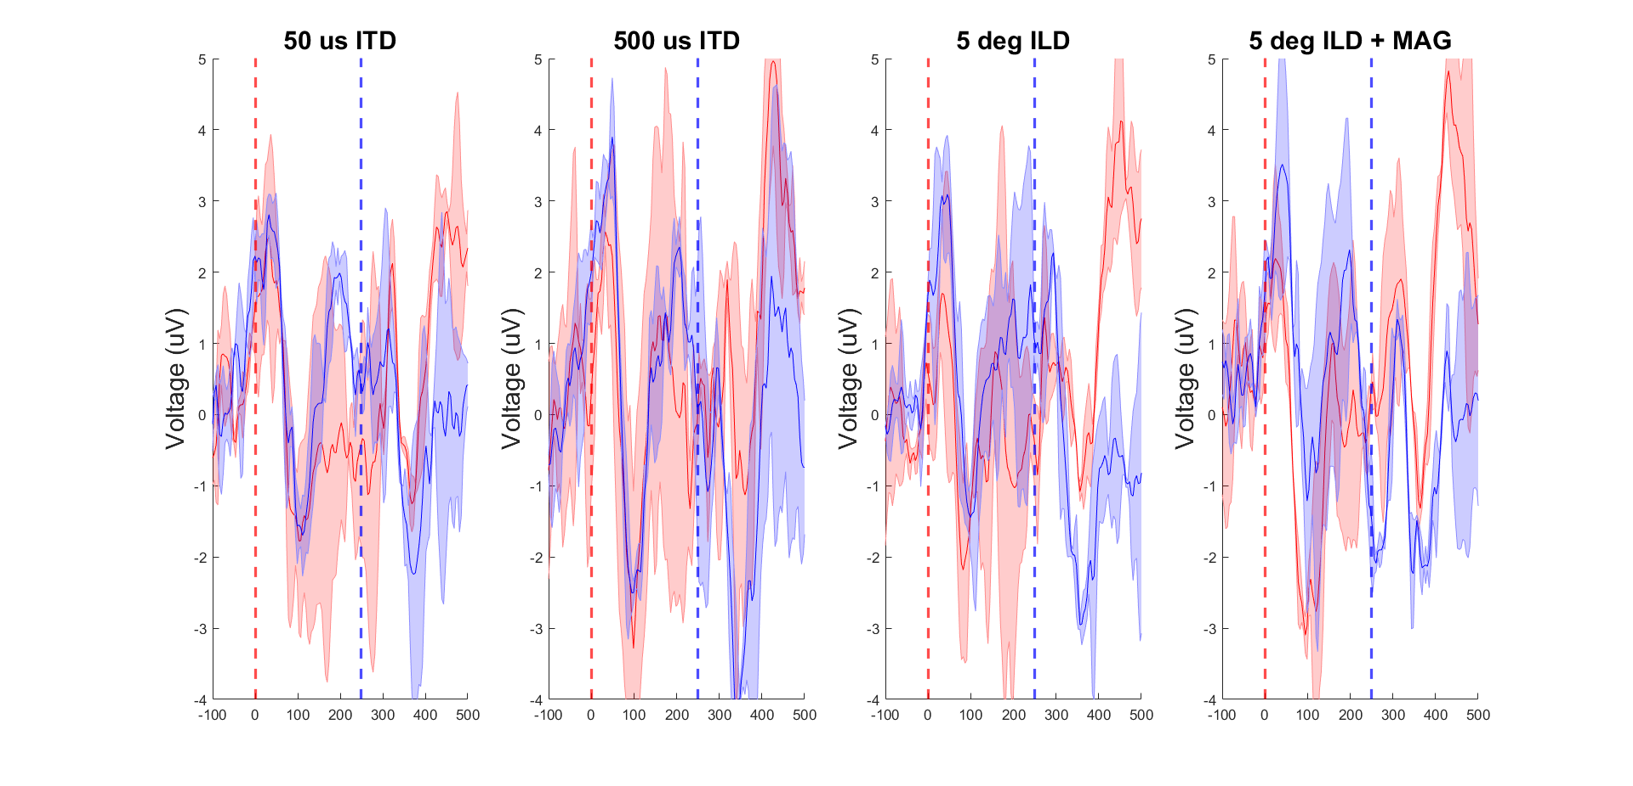
Frontocentral channels, ignoring first word pair, bash only

Slide 51
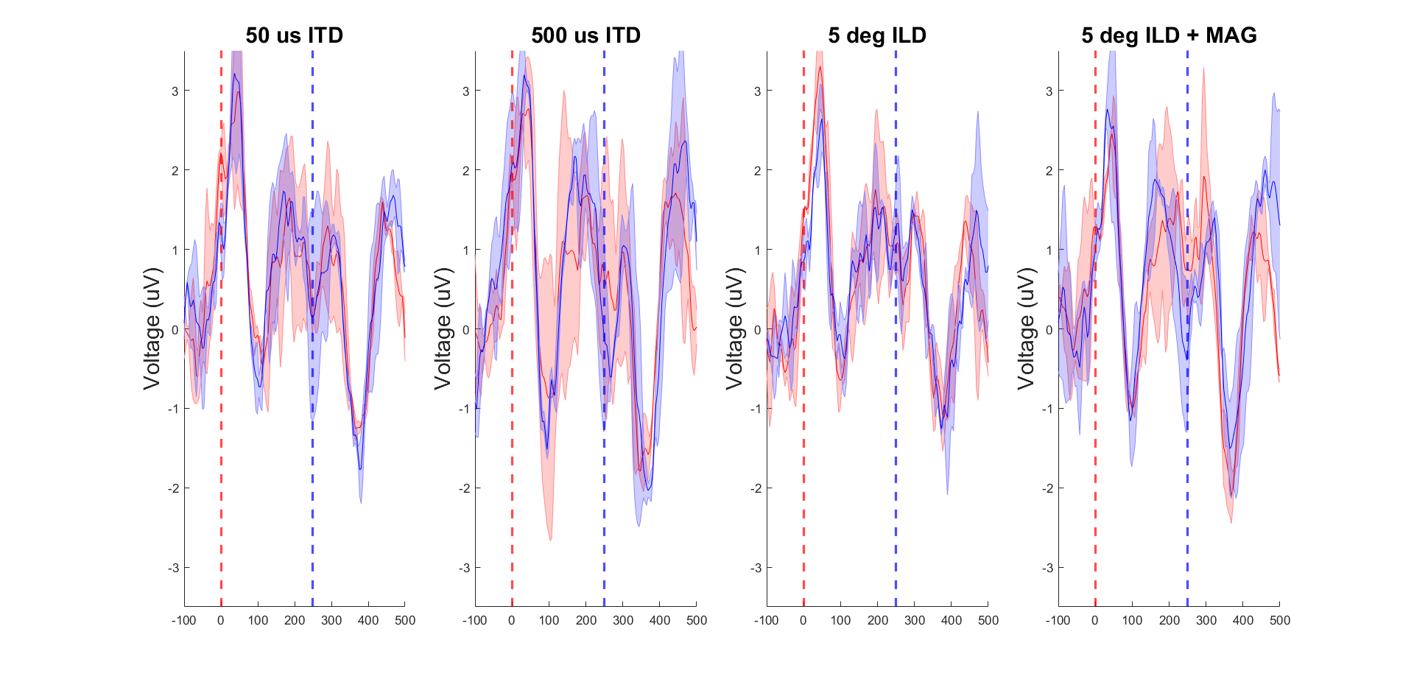
Frontocentral channels, ignoring first word pair, {dash,gash} only

Slide 52
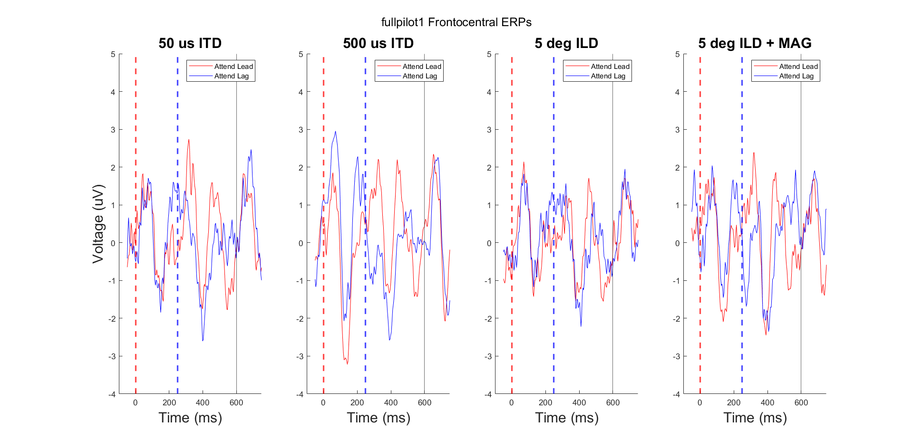
Ignoring first word pair individuals (all words)

Slide 53
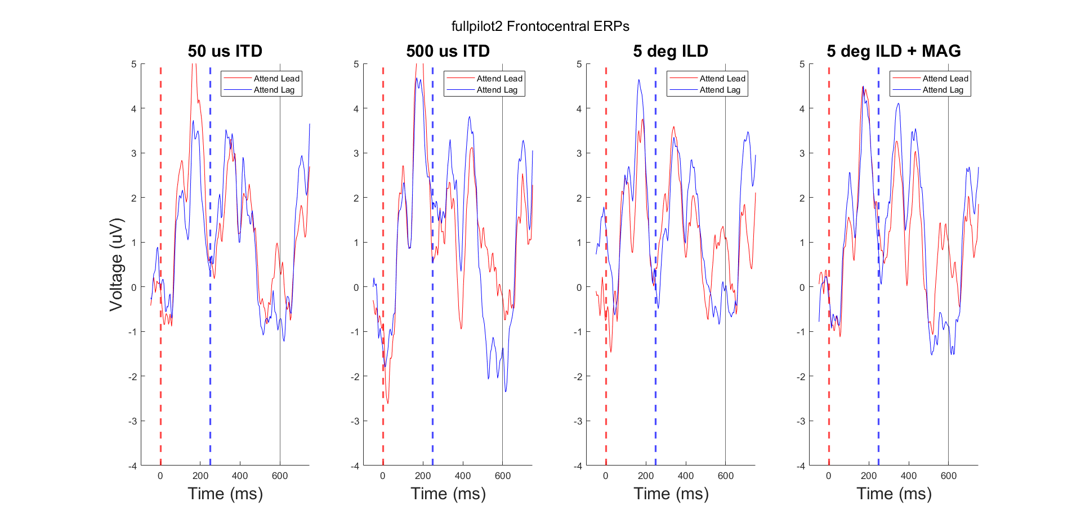

Slide 54
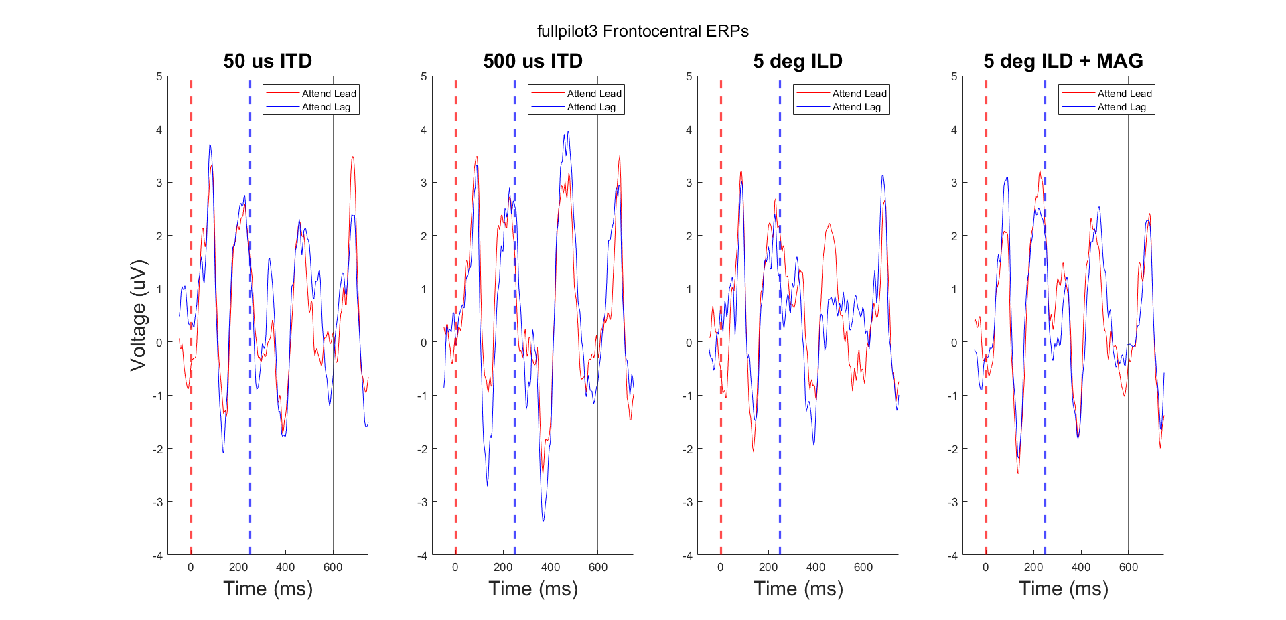

Slide 55
NIRS Block Averages
Averaged over all trials

